Slide 1




Software Engineering
Dr. Kaushal A Shah, Assistant Professor Computer Science and Engineering

Slide 2




UNIT-5
Coding and Unit Testing

Slide 3

Programming Principles and Guidelines
Select data structures that will meet the need of the design.
Keep conditional logic as simple as possible.
Understand the software architecture and make interfaces that are according to it.
Select meaningful variable names and follow other local coding standards.
Write code that's self-documenting.
Create a visual layout.
Constrain your algorithm by structured programming practice.

Slide 4
Programming Practices
Control construct
The single entry and exit constructs need to be used.
Use of goto
The goto statements make the program unstructured. So avoid use of goto statements as possible.
Information hiding
Nesting
Structure inside another structure is called as nesting. If there is too
deep nesting then it becomes hard to understand the code as well as complex.
User defined data types
User can define data type to enhance the readability of the code.
Image source : Google

Slide 5
Programming Practices (Contd.)
Modular size
The size of program may be large or small. There is no rule for size of the program. So as possible generate different module but not of large size.
Side effects
Sometimes if some part of code may change then it may generate some kind of problems called as side effects.
Robustness
If any kind of exception is generated, the program should generate some kind of output. Then it is called as robustness. In this situation the programs do not crash.
Switch case with defaults
Inside the switch case statement if any value which is unpredictable is given as argument then there should be default case to execute it

Slide 6
Coding Standards
Good software development organizations normally require their programmers to adhere to some well-defined and standard style of coding called coding standards.

Slide 7
Coding Standards (Contd.)
Most software development organizations formulate their own coding standards that suit them most, and need their engineers to follow these standards strictly.
The purpose of requiring all engineers of an organization to adhere to a standard style of coding is the following:
A coding standard gives a uniform appearance to the codes written by different engineers.
It enhances code understanding.
It encourages good programming practices.

Slide 8
Coding Standards (Contd.)
A coding standard lists several rules to be followed such as, the way variables are to be named, the way the code is to be laid out, error return conventions, etc.
The following are some representative coding standards:
Rules for limiting the use of global
These rules list what types of data can be declared global and what cannot.
Naming conventions for global & local variables & constant identifiers
A possible naming convention can be that global variable names always start with
a capital letter, local variable names are made of small letters, and constant names are always capital letters.

Slide 9
Coding Standards (Contd.)
Contents of the headers preceding codes for different modules
The information contained in the headers of different modules should be standard for an organization.
The exact format in which the header information is organized in the header can also be specified.
The following are some standard header data
Module Name Creation Date Author’s Name Modification history Synopsis of the module Global variables accessed/modifiedby the module
Different functions supported, along with their input/output parameters

Slide 10
Coding Standards (Contd.)
Error return conventions and exception handling mechanisms
The way error conditions are reported by different functions in a program are handled should be standard within an organization.
For example, different functions while encountering an error condition should either return a 0 or 1 consistently.

Slide 11


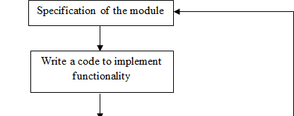


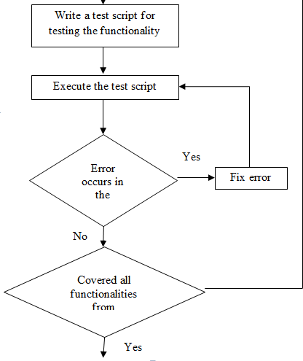
Incremental Development of Code
Then test that code based on some cases then execute the test script.
It should be checked that any kind of errors are generated then fix the errors.
If any kind of errors are not generated then covered all the functionalities mentioned in the specification, the process is terminated.
Each and every functionality is written and immediately tested is one of its advantages

Slide 12
Coding Guidelines
The following are some representative coding guidelines
Do not use a coding style that is too clever or too difficult to understand
The code should be well-documented
The length of any function should not exceed 10 source lines
Do not use goto statements

Slide 13
The Types of Faults
Algorithmic | Logic is wrong Code reviews
Syntax | Wrong syntax; typos Compiler
Computation/ Precision | Not enough accuracy
Documentation | Misleading documentation
Stress/Overload | Maximum load violated
Capacity/Boundary | Boundary cases are usually special cases
Timing/Coordination | Synchronization issues Very hard to replicate
Throughput/Performance | System performs below expectations
Recovery | System restarted from abnormal state
Hardware & related software | Compatibility issues
Standards | Makes for difficult maintenance

Slide 14
Code Review
Code Review is carried out after the module is successfully compiled and all the syntax errors have been eliminated.
Code Reviews are extremelycost-effective strategies for reduction in coding errors and to produce high quality code.
Types of Reviews
Code Walk
Code Inspection
Through

Slide 15
Code Walk Through
Code walk through is an informal code analysis technique.
The main objectives of the walk through are
to discover the
algorithmic and logical errors in the code.
A few members of the development team are given the code few days before the walk through meeting to read and understand code.
Each member selects some test cases and simulates execution of the code by hand
The members note down their findings to discuss these in a walk through meeting where the coder of the module is present.

Slide 16
Code Inspection
The aim of Code Inspection is to discover some common types of errors caused due to improper programming.
In other words, during Code Inspection the code is examined for the presence of certain kinds of errors.
  For instance, consider the classical error of writing a procedure that modifies a parameter while the calling routine calls that procedure with a constant actual parameter.
  It is more likely that such an error will be discovered by looking for these kinds of mistakes in the code.
In addition, commitment to coding standards is also checked.

Slide 17
Few Classical Programming Errors
Use of uninitialized variables
Jumps into loops
Non terminating loops
Array indices out of bounds
Improper storage allocation and de-allocation
Mismatches between actual and formal parameter in procedure calls
Use of incorrect logical operators or incorrect precedence among operators
Improper modification of loop variables

Slide 18
Software Documentation
When various kinds of software products are developed, various kinds of documents are also developed as part of any software engineering process e.g.
  Users’ manual,
  Software requirements specification (SRS) documents,
  Design documents,
  Test documents,
  Installation manual, etc

Slide 19
Software Testing
Testing is the process of exercising a program with the specific intent of finding errors prior to delivery to the end user.
Don’t view testing as a “safety net” that will catch all errors that occurred because of weak software engineering practice.

Slide 20
Who tests the Software?
Developer
Tester
Understands the system but, will test
Must learn about the system,
"gently"
but, will attempt to break it and,
and, is driven by "delivery"
is driven by quality
Testing without plan is of no point It wastes time and effort
Testing need a strategy Dev team
needs to work with Test team, “Egoless Programming”

Slide 21



When to test Software?
Component Code Component Code Component Code
UnitTest UnitTest UnitTest
DesignSpecs IntegrationTest
Integratedmodules
Systemfunctional
FunctionTest
Functioningsystem
requirements
Othersoftware
PerformanceTest
requirements
Customer SRS
Verified, validatedsoftware
Ac eptanceTest
Acceptedsystem
Userenvironment
Insta lationTest
Systeminuse!

Slide 22
Verification vs Validation
Verification
Are we building the product right?
The objective of Verification is to make sure that the product being develop is as per the requirements and design specifications.
Validation
Are we building the right product?
The objective of Validation is to make sure that the product actually meet up the user’s requirements, and check whether the specifications were correct in the first place.

Slide 23
Verification
vs
Validation (Contd.)
Process of evaluating products of a development phase to find out whether they meet the specified requirements.
Activities involved: Reviews, Meetings and Inspections
Carried out by QA team
Execution of code is not comes under Verification
Explains whether the according to inputs or not
Cost of errors caught is less
Process of evaluating software at the end of the development to determine whether software meets the customer expectations and requirements.
Activities involved: Testing like black box testing, white box testing, gray box testing
Carried out by testing team Execution of code is comes under
Describes whether the software is accepted by the user or not
Cost of errors caught is high
Validation
outputs are

Slide 24
Software Testing Strategy
Unit Testing
It concentrate on each unit of the software as implemented in source code.
It focuses on each component individual, ensuring that it functions properly as a unit.
Integration Testing
It focus is on design
software architecture
Integration testing is the process of testing the
and construction of
interface between two software units or modules

Slide 25
Software Testing Strategy (Contd.)
Validation Testing
Software is
validated against requirements
established as a part of requirement modeling
It give assurance that software meets all
and
informational, functional, behavioral performance requirements.
The software and other software elements are tested as a whole
Software once validated, must be combined
System Testing
with
other system elements e.g. hardware, people, database etc…
It verifies that all elements mesh properly and that overall system function / performance is achieved.

Slide 26
Unit Testing
Unit is the smallest part of a software system that is testable.
It may include code files, classes and methods which can be tested individually for correctness.
Unit Testing validates small building block of a complex system before testing an integrated large module or whole system
The unit test focuses on the internal processing logic and data structures within the boundaries of a component.

Slide 27
Unit Testing (Contd.)
The module is tested to ensure that information properly flows into and out of the program unit
Local data structures are examined to ensure that data stored temporarily maintains its integrity during execution
All independent paths through the control structures are exercised to ensure that all statements in module have been executed at least once
Boundary conditions are tested to ensure that the module operates properly at boundaries established to limit or restricted processing
All error handling paths are tested.

Slide 28
Unit Testing (Contd.)
Component-testing (Unit Testing) may be done in isolation from rest of the system
In such case the missing software is replaced by Stubs and Drivers and simulate the interface between the software components in a simple manner

Slide 29
Unit Testing (Contd.)
Let’s take an example to understand it in a better way.
Suppose there is an application consisting of three
modules
say, module A, module B & module C.
Developer has design in such a way that module B depends on module A & module C depends on module B
The developer has developed the module B and now wanted to test it.
But the module A and module C has not been developed yet.
In that case to test the module B completely we
can replace
the module A by Driver and module C by stub

Slide 30
Unit Testing (Contd.)
Driver and/or Stub software must be developed for each unit test
A driver is nothing more than a "main program"
  It accepts test case data
  Passes such data to the component and
  Prints relevant results.
Driver
  Used in Bottom up approach
  Lowest modules are tested first.
  Stimulates the higher level of components
  Dummy program for Higher level component

Slide 31
Unit Testing (Contd.)
Stubs serve to replace modules that are subordinate (called by) the component to be tested.
A stub or "dummy subprogram"
  Uses the subordinate module's interface
  May do minimal data manipulation
  Prints verification of entry and
  Returns control to the module undergoing testing
Stubs
  Used in Top down approach
  Top most module is tested first
  Stimulates the lower level of components
  Dummy program of lower level components

Slide 32
Metrics
Metrics are quantitative measure that the software engineer to gain the efficiency of the process
Types of Measures
Size
Complexity
Measure
Measure

Slide 33



Size Measure
Size oriented measure is derived by considering the size of software that has been produced.
Any organization builds a simple record of size measure for the software projects. It is built based on past experiences.
Set of size measure is given below:
Size = Kilo Line of Code
Effort = Person month
Productivity = KLOC/Person-month
Cost = $/KLOC
Quality = Number of faults / KLOC
Documentation = Pages/KLOC
Size measure is based on line of code computation.

Slide 34


Complexity Measure
If the complexity is measured in terms of line of code then it may vary from system to system.
Complexity can be done by various methods such as cyclomatic complexity, Halstead measure and Knot count measure.
Cyclomatic complexity
  Independent path is any path through use of the program that introduces at least one new set of processing statements or a new condition.
  Cyclomatic complexity is software metric that provides a quantitative measure of the logical complexity of a program.
  It defines number of independent paths in the basis of set of program and provides us with an upper bound for the number of tests that must be conducted to ensure all statements have been executed at least once.

Slide 35



Cyclomatic Complexity
It can be computed 3 ways:
The number of regions corresponds to cyclomatic complexity.
Cyclomatic complexity V (G) can be defined as
V (G) =E-N+2
Where E is number of flow graph edges and N is the number of flow graph nodes.
Cyclomatic complexity V (G) can also be defined as
V (G) = P + 1
Where P is the number of predicate nodes contained in the graph.

Slide 36
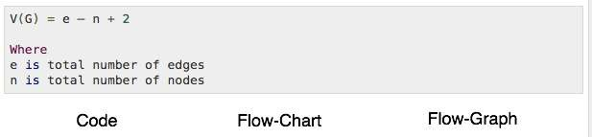
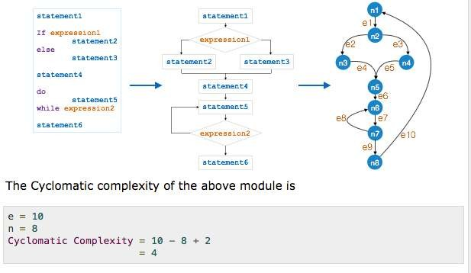
Cyclomatic Complexity

Slide 37
Halstead Measure
Halstead's theory of software science is one of "the best known and most thoroughly studied composite measures of (software) complexity".
Software science assigns quantitative laws to the development of computer software, using a set of primitive measures that may be derived after code is generated or estimated once design is complete.

Slide 38


Halstead Measure (Contd.)
These follow:
n1= the number of distinct operators that appear in a program. n2= the number of distinct operands that appear in a program. N1= the total number of operator occurrences. N2= the total number of operand occurrences.
 | Symbol | Formula
Program Length | N | N = N1 + N2
Program Vocabulary Volume | n V | n = n1 + n2 V = N * (log2n)
Difficulty | D | D = (n1/2) * (n2/2)
Effort | E | E = D * V

Slide 39




Halstead Measure (Contd.)
Program Length
The length of a program is total usage of operators and operands in the program.
Length = N1 + N2
Program vocabulary
The program vocabulary is the number of unique operators and operands used in the program.
Vocabulary n = n1 + n2
Program Volume
The program volume can be defined as the maximum number of bits to encode the program.
V=Nlog2n
Halstead shows that length N can be estimated N= n1log2n1+ n2log2n2

Slide 40



Knot Count
Knot is a crossing of control flows. These crossings occur due to non- structural
jumps in the program.
Typically the goto statements cause this kind of non-structural jump. This metric is designed for FORTRAN language.
If the knot is more intertwined then that means the program is more complex.
The code with large knots is generally extremely difficult to read and understand.
The example is shown on the right side.

Slide 41
Comparison of Different Metrics
Size measure
Cyclomatic Complexity Halstead’s
Knot count
measure
This is simple method of obtaining the
This measure is based on the control flow of the programming
The measurable quantities of
It is basically designed for the FORTRAN
metrics. It is based on lines of code.
constructs such as if then else, do-while, repeat-until and so on.
the program are operators and operands.
programs.
Modules of the same size can have different complexities.
For larger number of decisions larger is the complexity.
It is based on
More number of knots indicates more
complex in the program.
length and
volume of the program.

Slide 42
www.paruluniversity.ac.in

